Slide 1
MINI PROJECT
DIABETES DETECTION USING MACHINE LEARNING
BY:
SANYA NEGI 17BCS046
SHRUTI RAJ VASH SINGH 17BCS049

Slide 2
INTRODUCTION:
Diabetes is a disease that occurs when your blood glucose, also called blood sugar, is too high. Blood glucose is your main source of energy and comes from the food you eat. Insulin, a hormone made by the pancreas, helps glucose from food get into your cells to be used for energy.
According to a study, titled ‘Variation in health system performance for managing diabetes among states in India: a cross-sectional study of individuals aged 15 to 49 years’ done in May 2019, about one in every two Indians (47%) living with diabetes is unaware of their condition, and only about a quarter (24%) manage to bring it under control.
As of 2017, India had 72.9 million diabetes patients--second only to China (114.3 million), according to the International Diabetes Federation’s Diabetes Atlas 2017.

Slide 3
Diabetes increases the risk of heart disease by about four times in women but only about two times in men, and women have worse outcomes after a heart attack. Women are also at higher risk of other diabetes-related complications such as blindness, kidney disease, and depression.
IS A PERSON DIABETIC?
NO
(Not dangerous for health)
YES
(has a potential to be dangerous)

Slide 4
WHAT IS THE NEED?
Early detection and treatment of diabetes is an important step toward keeping people with diabetes healthy. It can help to reduce the risk of serious complications such as premature heart disease and stroke, blindness, limb amputations, and kidney failure. Because of its unique advantages in critical features detection from complex Diabetes datasets, machine learning (ML) is widely recognized as the methodology of choice in diabetes pattern classification and forecast modelling.
Classification and data mining methods are an effective way to classify data. Especially in medical field, where those methods are widely used in diagnosis and analysis to make decisions.

Slide 5
OBJECTIVE:
This analysis aims to observe which features are most helpful in predicting if a person is diabetic and to see general trends that may aid us in model selection and hyper parameter selection.
The goal is to classify whether a person is suffering from diabetics or not by through a GUI that takes in input and uses machine learning model to make the prediction.

Slide 6
PHASES:
Data Preparation
Data Exploration
Model Selection
Standardization
Feature Extraction

Slide 7
DATA PREPARATION :
This dataset is originally from the National Institute of Diabetes and Digestive and Kidney
Diseases. The objective of the dataset is to diagnostically predict whether or not a patient has diabetes, based on certain diagnostic measurements included in the dataset. Several constraints were placed on the selection of these instances from a larger database. In particular, all patients here are females at least 21 years old of Pima Indian heritage.

Slide 8
DATASET INFORMATION :
Pregnancies: Number of times pregnant
Glucose: Plasma glucose concentration a 2 hours in an oral glucose tolerance test
BloodPressure: Diastolic blood pressure (mm Hg)
SkinThickness: Triceps skin fold thickness (mm)
Insulin: 2-Hour serum insulin (mu U/ml)
BMI: Body mass index (weight in kg/(height in m)^2)
DiabetesPedigreeFunction: Diabetes pedigree function
Age: Age (years)
OutcomeClass variable (0 or 1): 268 of 768 are 1, the others are 0

Slide 9
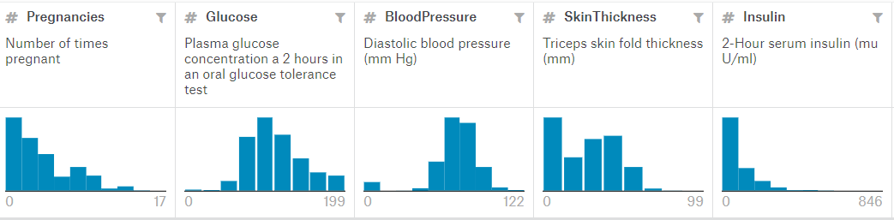
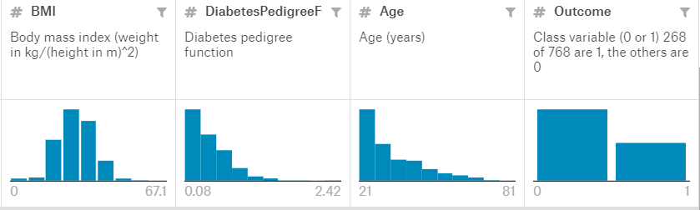

Slide 10
MODEL SELECTION :
MACHINE LEARNING ALGORITHMS
SUPERVISED LEARNING
UNSUPERVISED LEARNING
REGRESSION
OUTPUT IS REAL OR CONTINUOUS
CLASSIFICATION
OUTPUT VARIABLE IS A CATEGORY
CLUSTERING
SEGREGATES GROUPS WITH SIMILAR DATA

Slide 11
CLASSIFICATION ALGORITHMS:
Logistic Regression
Nearest Neighbor
Support Vector Machine(SVM)
Kernel Support Vector Machine
Naïve Bayes
Decision Tree Classification
Random Forest Classification

Slide 12
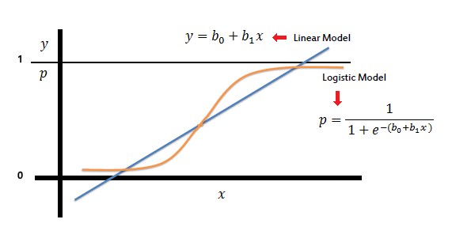
LOGISTIC REGRESSION:
Logistic Regression algorithm measures the relationship between the categorical dependent variable and one or more independent variables by estimating probabilities using a logistic/sigmoid function.

Slide 13
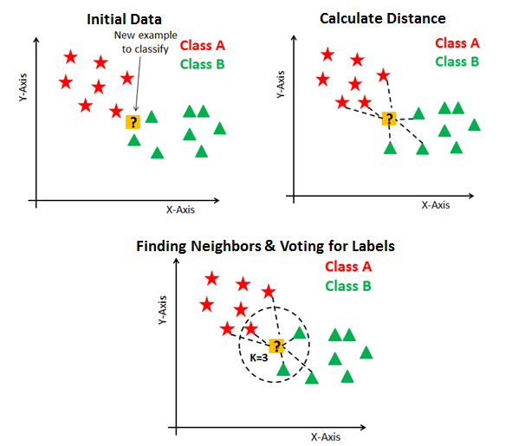
K-NEAREST NEIGHBORS :
In a KNN algorithm, a test sample is given as the class of majority of its nearest neighbours. In plain words, if you are similar to your neighbours, then you are one of them.

Slide 14
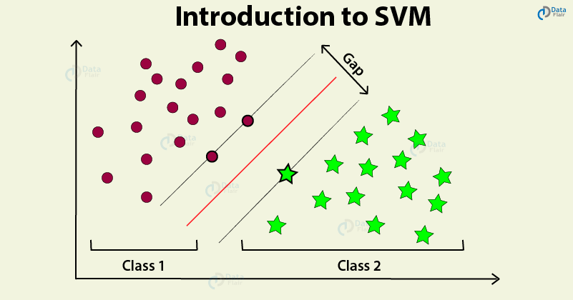
SUPPORT VECTOR MACHINE (SVM)
In this algorithm, we plot each data item as a point in n-dimensional space (where n is number of features we have) with the value of each feature being the value of a particular coordinate. Then, we perform classification by finding the hyper-plane that differentiate the two classes very well.

Slide 15
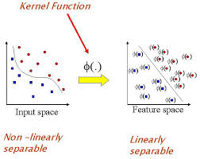
KERNEL SVM :
Kernel is essentially a mapping function - one that transforms a given space into some other (usually very high dimensional) space. This algorithm does not categorise the data linearly instead the kernel function of one of the following types is used - polynomial, Gaussian RBF, Sigmoidal

Slide 16
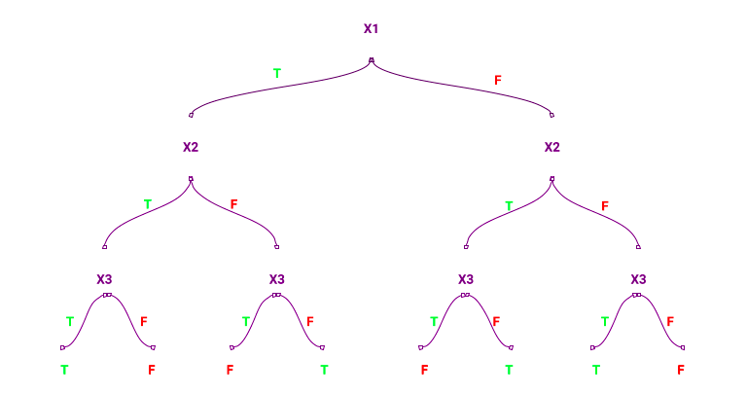
DECISION TREES
A decision tree is a tree-like graph with nodes representing the place where we pick an attribute and ask a question; edges represent the answers the to the question; and the leaves represent the actual output or class label. They are used in non-linear decision making with simple linear decision surface.

Slide 17
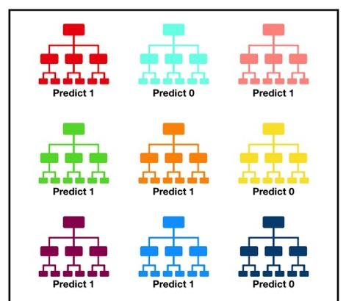
RANDOM FOREST
Random forest, like its name implies, consists of a large number of individual decision trees that operate as an ensemble. Each individual tree in the random forest spits out a class prediction and the class with the most votes becomes our model’s prediction (see figure below).

Slide 18
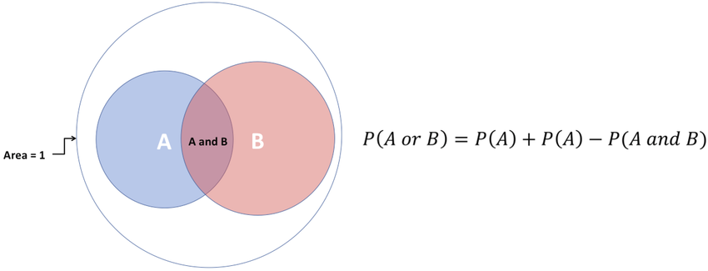
NAIVE BAYES :
Naive Bayes classifiers are a collection of classification algorithms based on Bayes’ Theorem. It is not a single algorithm but a family of algorithms where all of them share a common principle, i.e. every pair of features being classified is independent of each other.

Slide 19
VOTING METHOD
We can train our model using diverse algorithms and then ensemble them to predict the final output. As we are using Random Forest Classifier, SVM Classifier, Logistic Regression etc.; models are pitted against each other and selected upon best performance by voting using the VotingClassifier Class from sklearn.ensemble.
We used Hard Voting and found that Naive Bayes, Support Vector Machine and Logistic Regression when grouped together to form the ensemble method give the best results.

Slide 20
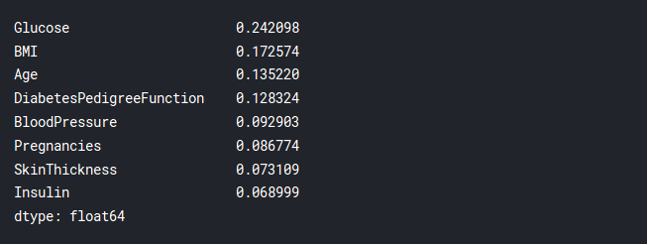
FEATURE EXTRACTION
A lot many features can affect the accuracy of the algorithm. Feature Extraction means to select only the important features in-order to improve the accuracy of the algorithm.It reduces training time and reduces overfitting
The following image shows the important features are: Glucose, BMI, Age, DiabetesPedigreeFunction.

Slide 21
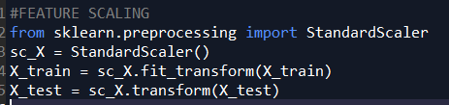
STANDARDISATION
There can be a lot of deviation in the given dataset. An example in the dataset can be the BMI where it has 248 unique values. This high variance has to be standardised. Standardization is a useful technique to transform attributes with a Gaussian distribution and differing means and standard deviations to a standard Gaussian distribution with a mean of 0 and a standard deviation of 1.
We used standard scaler from the sklearn preprocessing library to get all the values of features between -1 and 1 to make them comparable.

Slide 22
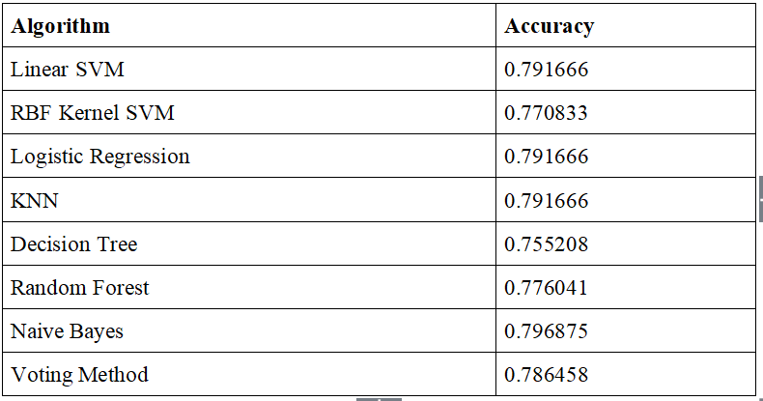
RESULTS
Before Feature Scaling, the accuracies are as given below-

Slide 23
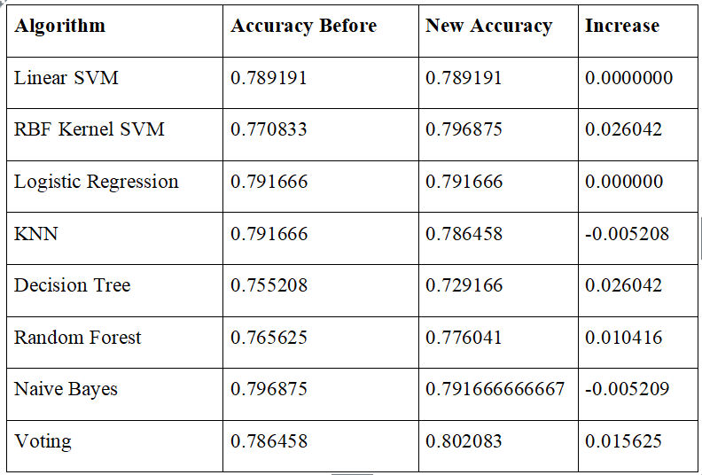
RESULTS
After Feature Scaling and Standardization, the accuracies are as given below-
So the maximum Accuracy which we could get by using ensemble models is 80.2083%.

Slide 24
GRAPHICAL USER INTERFACE
The GUI is built using tkinter in python.
Takes the values of features as inputs such as GLucose level, Insulin, Pregenancy etc from the person and outputs whether the person is diabetic or not.

Slide 25
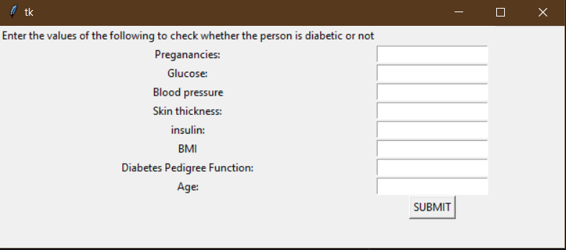
GRAPHICAL USER INTERFACE

Slide 26
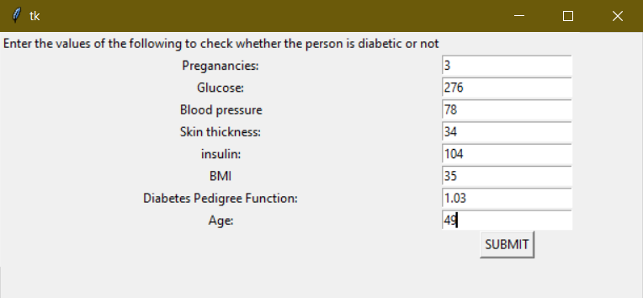
GRAPHICAL USER INTERFACE

Slide 27
FUTURE WORK:
The technique may be used by researchers to develop an accurate and effective tool that will reach at the table of clinicians to help them make better decisions about the disease status.
Investigating different deep learning methods like neural networks to improve the performance of the model.
Improved GUI for better User Experience.

Slide 28
THANK YOU

